Slide 1
CSC 439/539 Statistical Natural Language Processing Lecture 8: Dependency Parsing
Mihai Surdeanu
Fall 2017

Slide 2
Take-away
Shift-reduce dependency parsing algorithms for projective trees
Shift-reduce dependency parsing algorithms for directed acyclic graphs
Tree LSTMs

Slide 3
Readings
Dan Jurafsky. Speech and Language Processing, 3rd edition, chapter 14. https://web.stanford.edu/~jurafsky/slp3/14.pdf
Danqi Chen and Christopher D. Manning. A Fast and Accurate Dependency Parser using Neural Networks. https://cs.stanford.edu/~danqi/papers/emnlp2014.pdf
Kenji Sagae, Jun’ichi Tsuji. Shift-reduce Dependency DAG Parsing. https://aclweb.org/anthology/C/C08/C08-1095.pdf
Mihai Surdeanu and Christopher D. Manning. Ensemble Models for Dependency Parsing: Cheap and Good? http://surdeanu.info/mihai/papers/naacl10-parsing.pdf
Kai Sheng Tai, Richard Socher, Christopher D. Manning. Improved Semantic Representations From Tree-Structured Long Short-Term Memory Networks. https://arxiv.org/pdf/1503.00075.pdf

Slide 4
Take-away
Shift-reduce dependency parsing algorithms for projective trees
Shift-reduce dependency parsing algorithms for directed acyclic graphs
Tree LSTMs

Slide 5
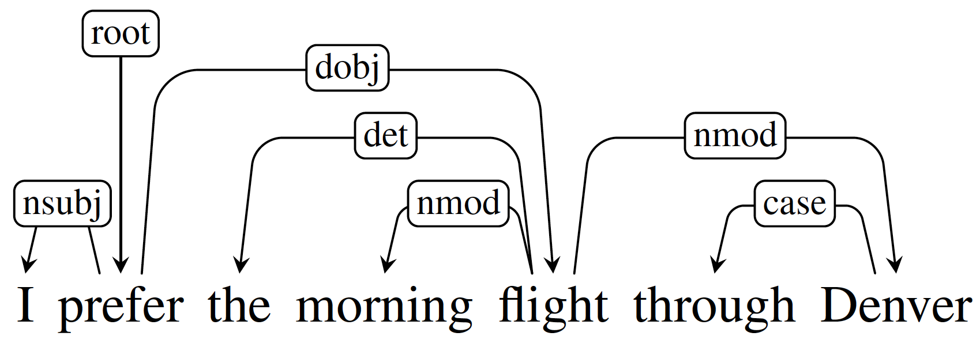
Remember this?
Typed dependency structure

Slide 6
Typed dependency structures
A set of binary dependency relations for a sentence
Head: central organizing word of a larger constituent
Modifier: depends on the head word
Label: indicates the grammatical function captured

Slide 7
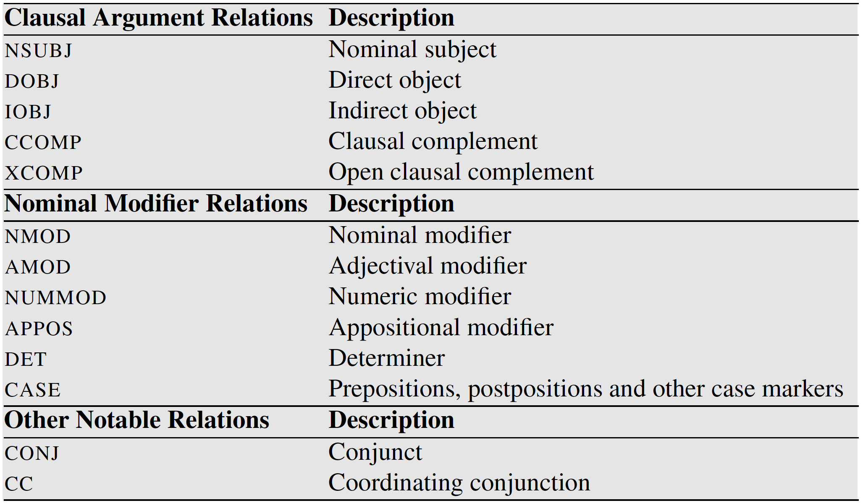
Selected dependency relations from the Universal Dependency set

Slide 8
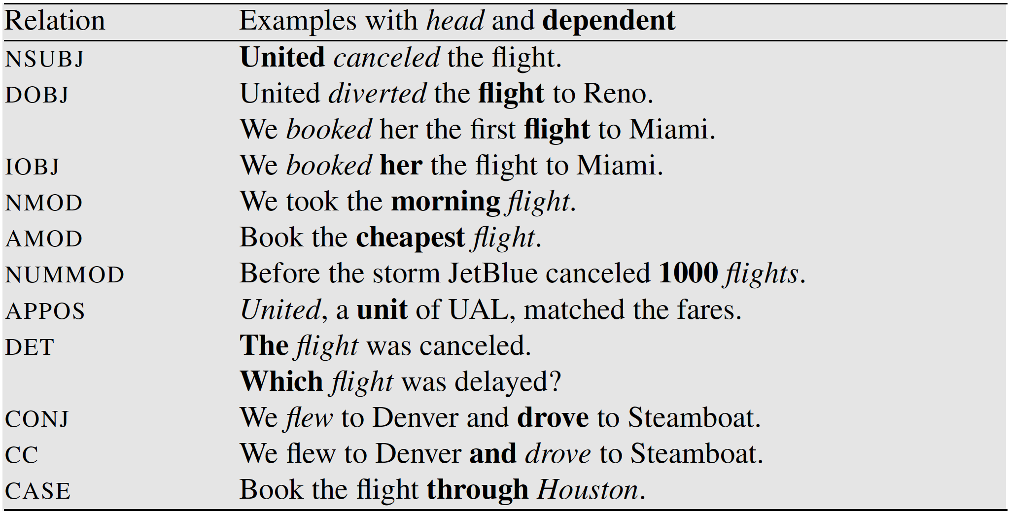
Exercise: what are the dependency labels in these examples?

Slide 9
Exercise: what are the dependency labels in these examples?

Slide 10
Exercise: what is the unlabeled dependency tree for this sentence?
I ate a bagel today with sesame seeds .
This example has a non-projective tree (crossing edges)!

Slide 11
Practice Exercise
Draw the dependency trees following universal dependencies for these sentences:
John Doe visited China.
I saw a girl with the telescope.
They told him a story.
A hearing is scheduled on the issue today.
JetBlue canceled our flight this morning which was already late.
The last 2 examples have non-projective trees!

Slide 12
Properties of dependency trees
There is a single designated root node that has no incoming arcs.
With the exception of the root node, each word has exactly one incoming arc (one head).
There is a unique path from the root node to each word in the sentence.

Slide 13
Projectivity
Not a theoretical requirement, but useful in practice because
Training data was generated from the original constituent-based treebanks resulting in projective trees
The simplest algorithms produce projective trees

Slide 14
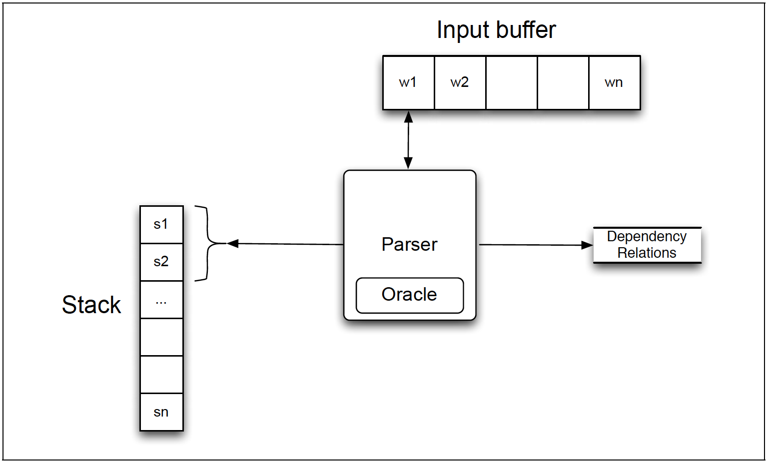
Shift-reduce (or transition-based) algorithms

Slide 15
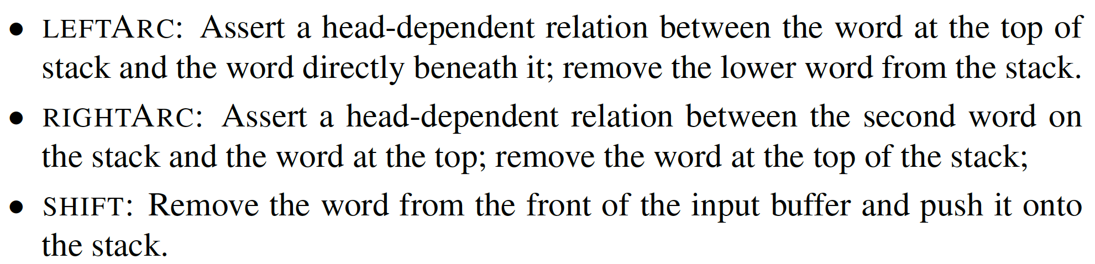
Arc-standard algorithm
Possible actions:

Slide 16
Arc-standard algorithm
Possible actions:
LeftArc and RightArc will be subclassed with the label of the dependency to be created, e.g., LeftArc-nsubj, LeftArc-dobj...
How many classes will your multi-class classifier have?

Slide 17
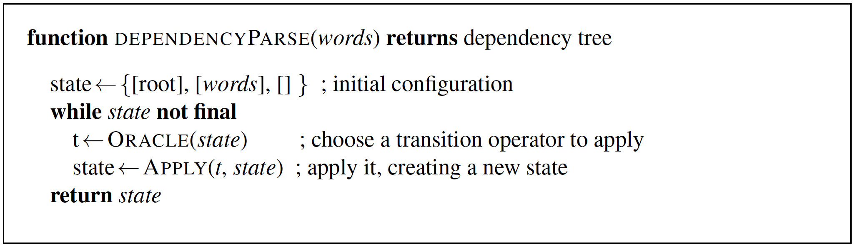
Generic transition-based dependency parser
Stack
Input buffer
Training: Correct action given gold data
Testing: Decision of a multi-class classifier
State is final when it contains a single tree anchored at root

Slide 18
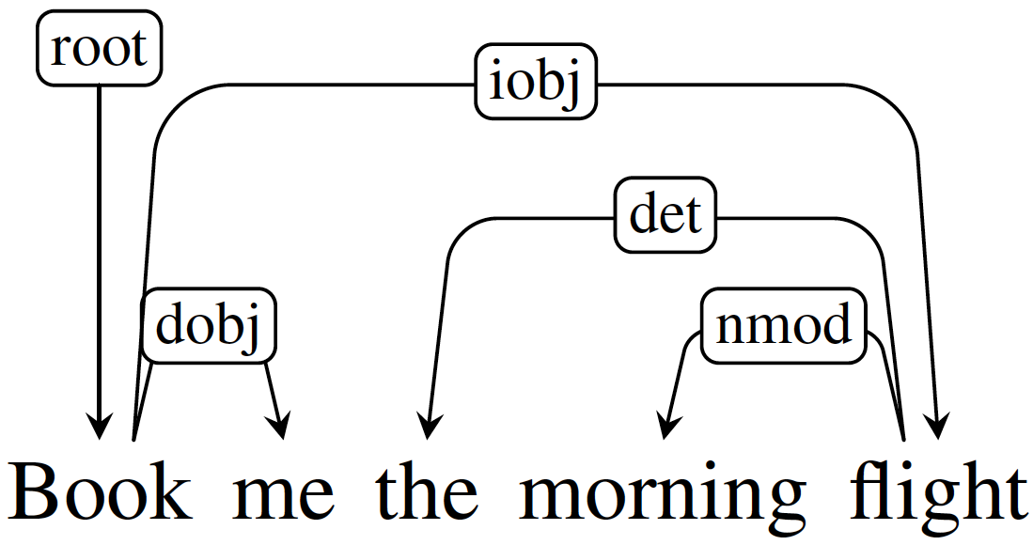
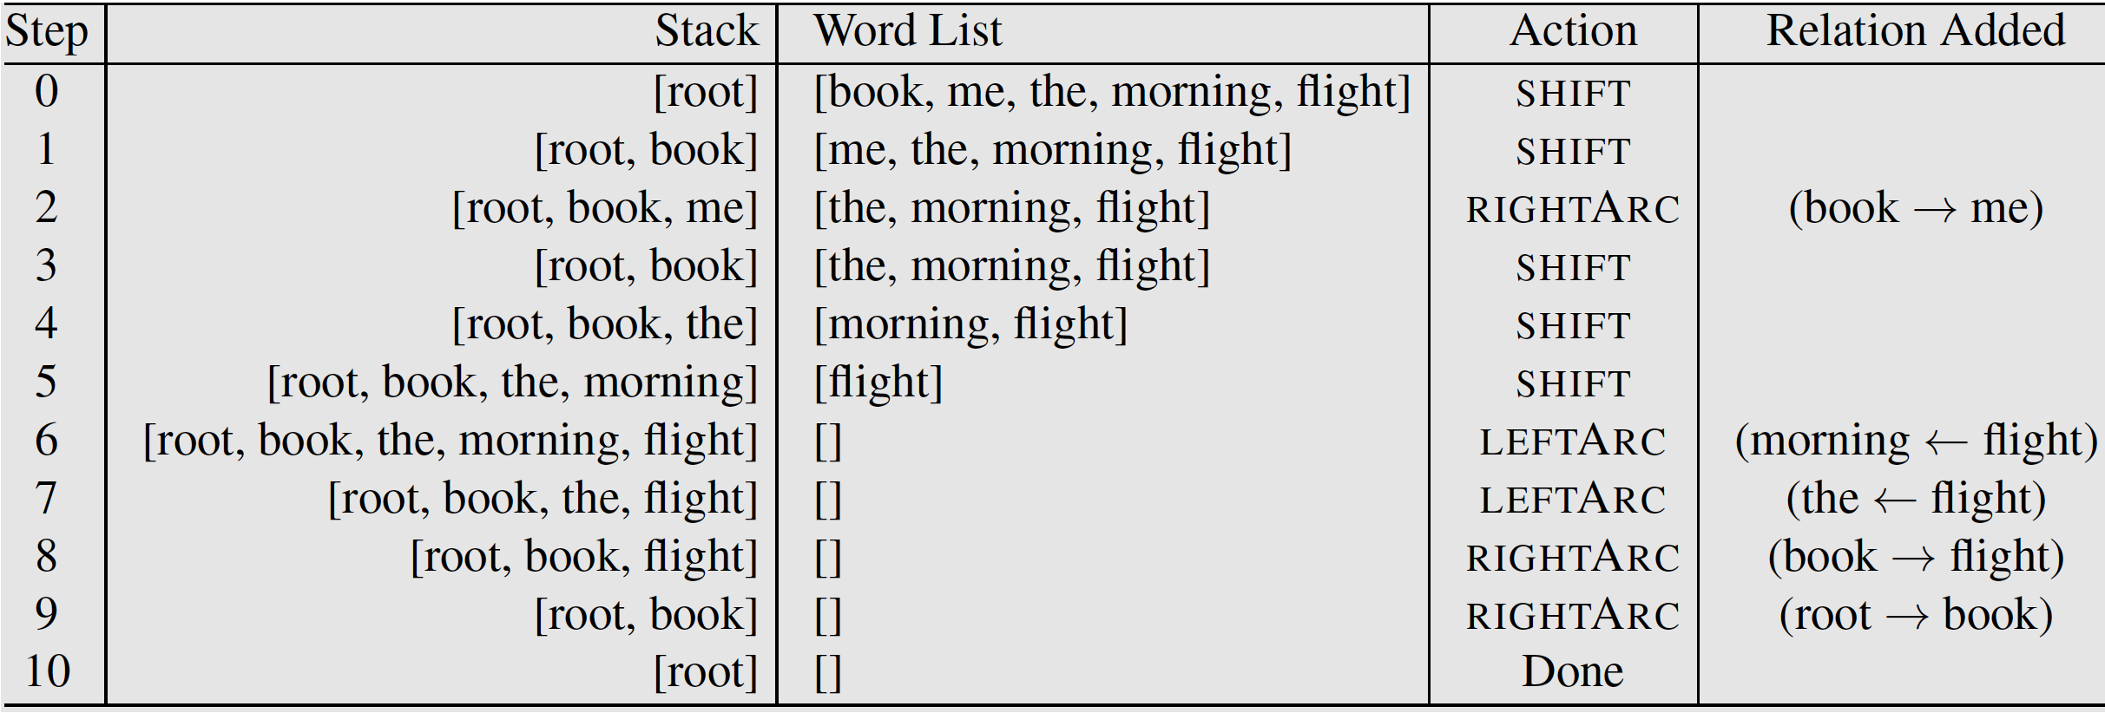
Example: gold actions for arc-standard

Slide 19
Example: gold actions for arc-standard

Slide 20
Example: gold actions for arc-standard

Slide 21
Example: gold actions for arc-standard

Slide 22
Example: gold actions for arc-standard

Slide 23
Example: gold actions for arc-standard

Slide 24
Example: gold actions for arc-standard

Slide 25
Example: gold actions for arc-standard
How many actions for a sentence of length N?
Notes:
2N

Slide 26
Practice Exercise
Generate the program trace for the arc-standard algorithm for the sentences:
John Doe visited China.
I saw a girl with the telescope.
They told him a story.

Slide 27
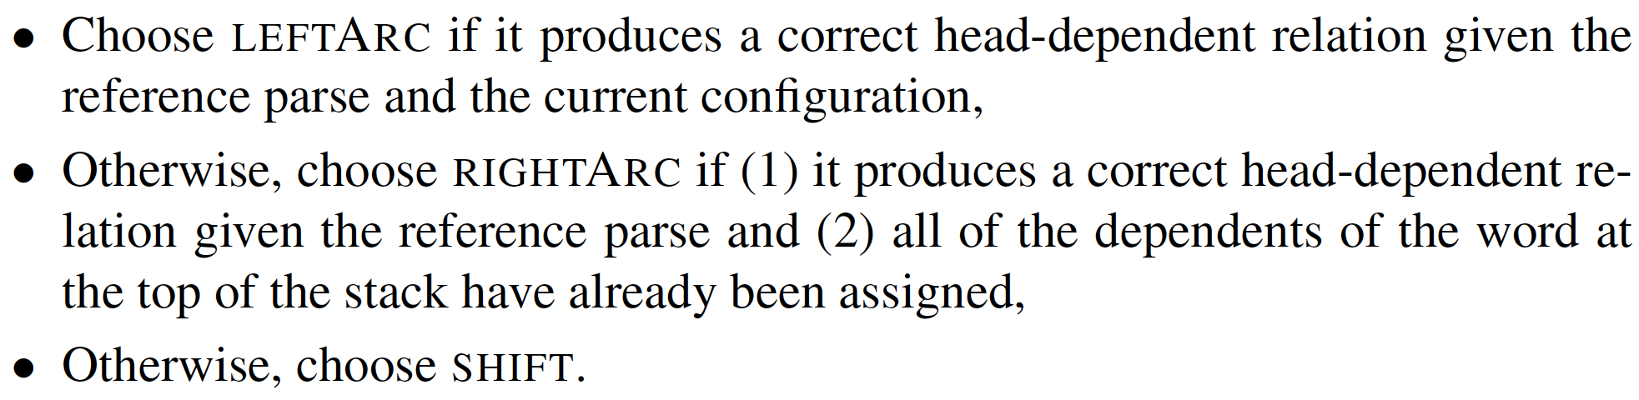
Generating training data: the oracle
The training oracle generates actions for a given state as follows:
Then train your favorite multi-class classifier on these actions!
Why?

Slide 28
Features
Generally from:
Top level(s) of the stack
Words near the front of the buffer
The dependency relations already created

Slide 29
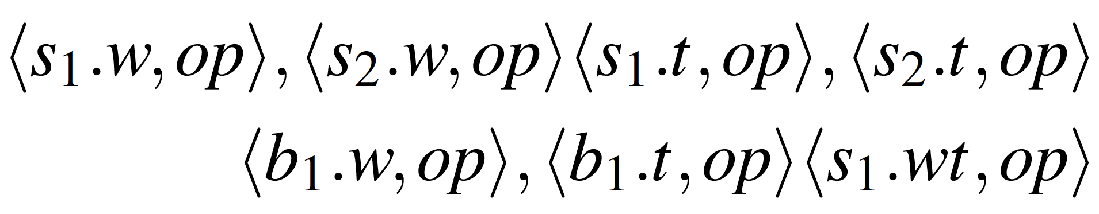
Features example
s – stack
b – input buffer
w - word
t – POS tag
op – dependency relation

Slide 30
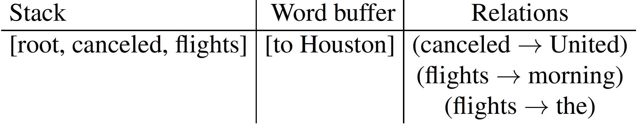
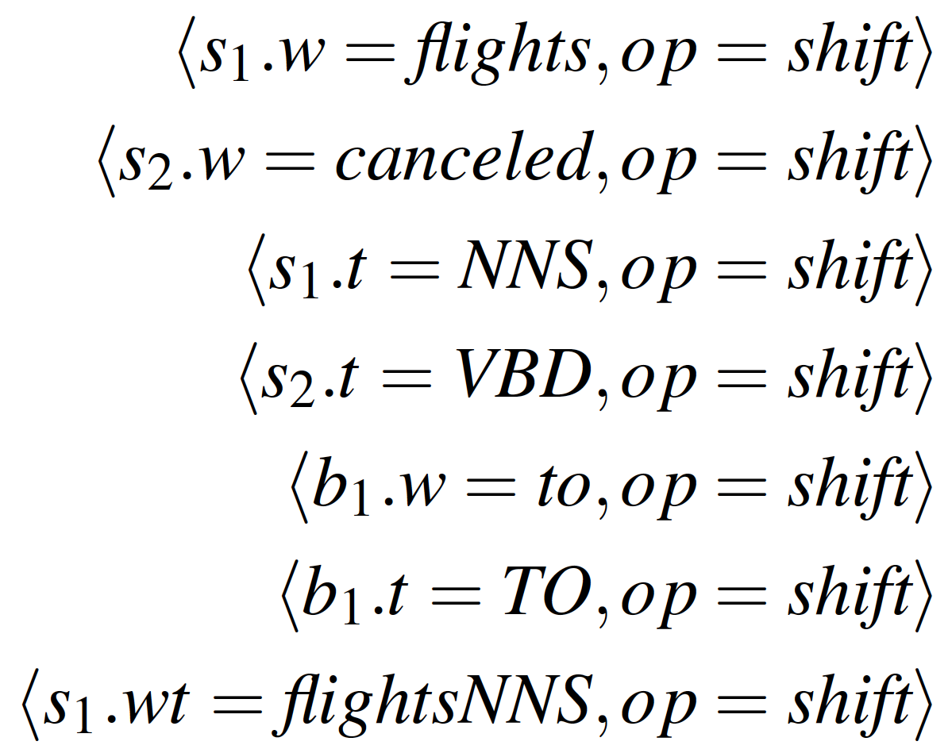
Features example

Slide 31
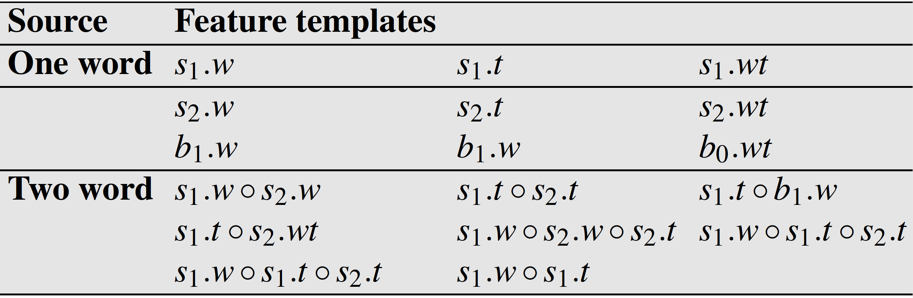
Feature combinations
Concatenation operator

Slide 32
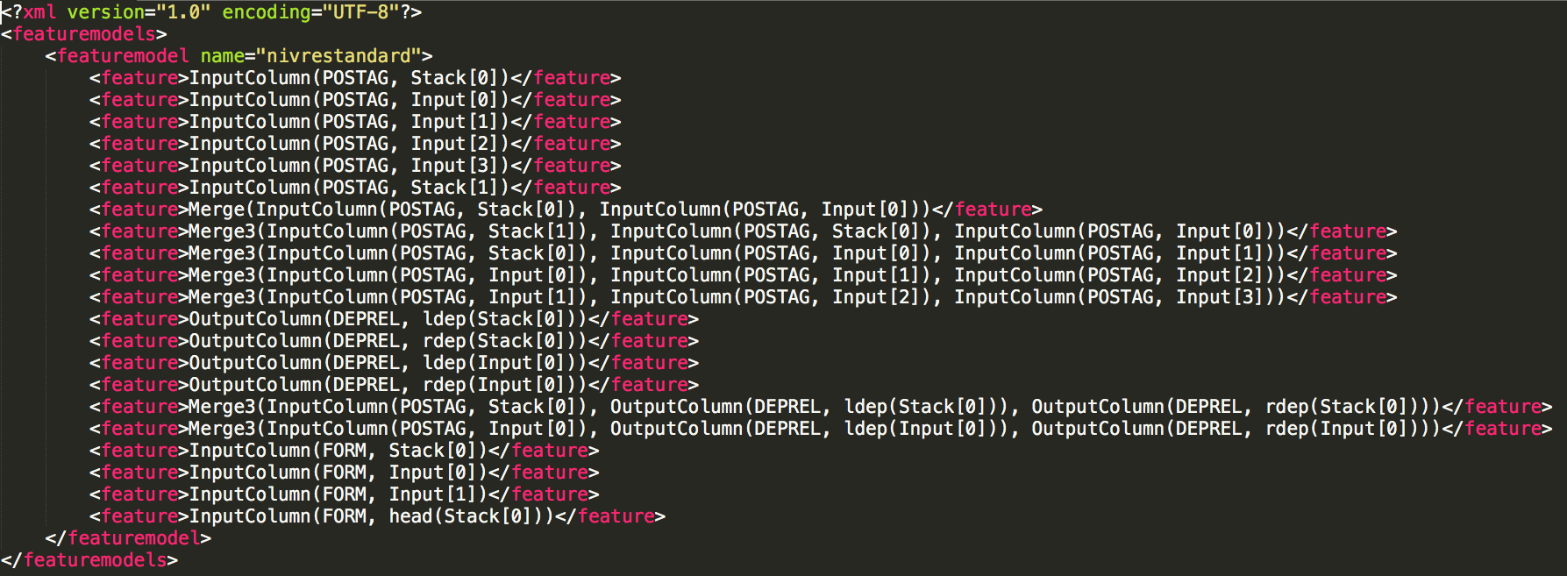
Concrete example: features for arc-standard in maltparser
DEPREL – label of dependency relation, FORM – word, POSTAG – POS tag, ldep - dependency having this word as head, rdep - dependency having this word as modifier

Slide 33
Classifiers
Any multi-class classifier works!
Maltparser supports
Logistic regression
Linear SVM
Non-linear SVM
We can use neural networks here!
See (Chen and Manning, 2014) next slides

Slide 34
Using NNs to train a shift-reduce parser: Motivation
Explicit features are sparse (especially in combination)
Explicit features incompletely capture the relevant phenomena
Generating explicit features is expensive (especially in combination)

Slide 35
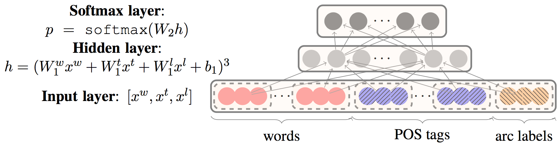
NN for shift-reduce parsing
Cube activation function shown to be better empirically than sigmoid and tanh
Words, POS tags, and arc labels given by a configuration similar to maltparser.
Everything (including POS tags and dependency labels) is embedded!

Slide 36
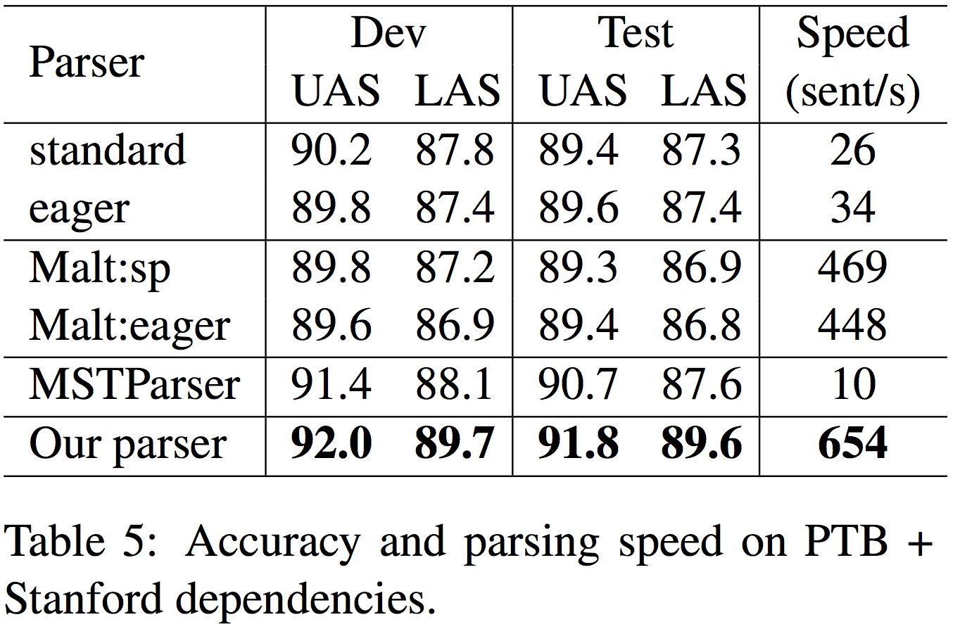
NN results

Slide 37
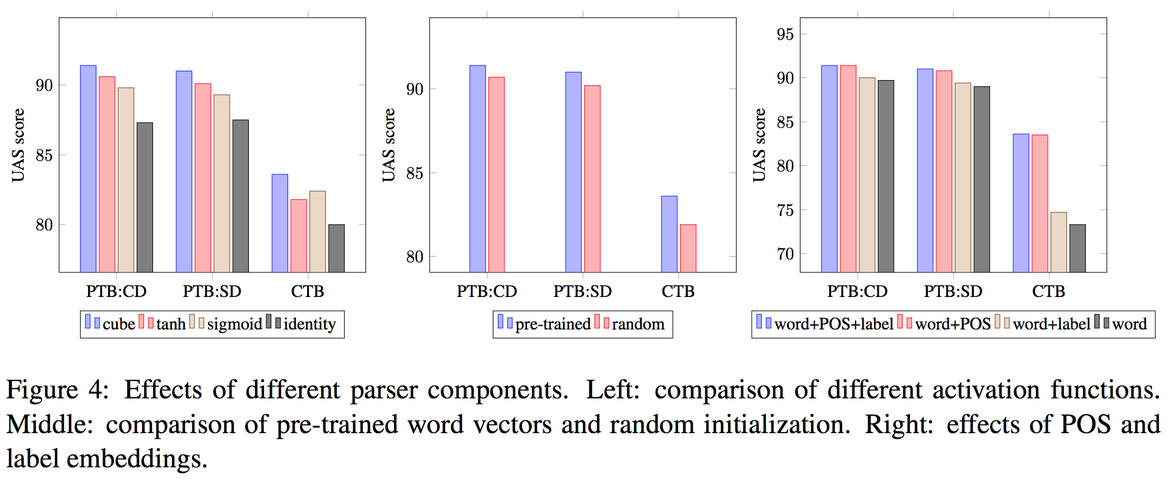
NN analysis

Slide 38
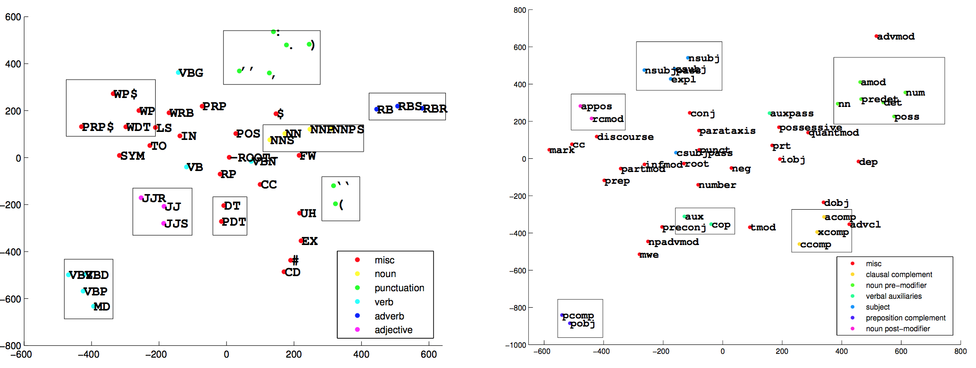
Visualization of POS and dependency label embeddings

Slide 39
Practice Exercise
How would you use NNs in a better way for this task?
Hint: the stack and the input buffer are sequences…

Slide 40
Alternative parsing algorithms

Slide 41
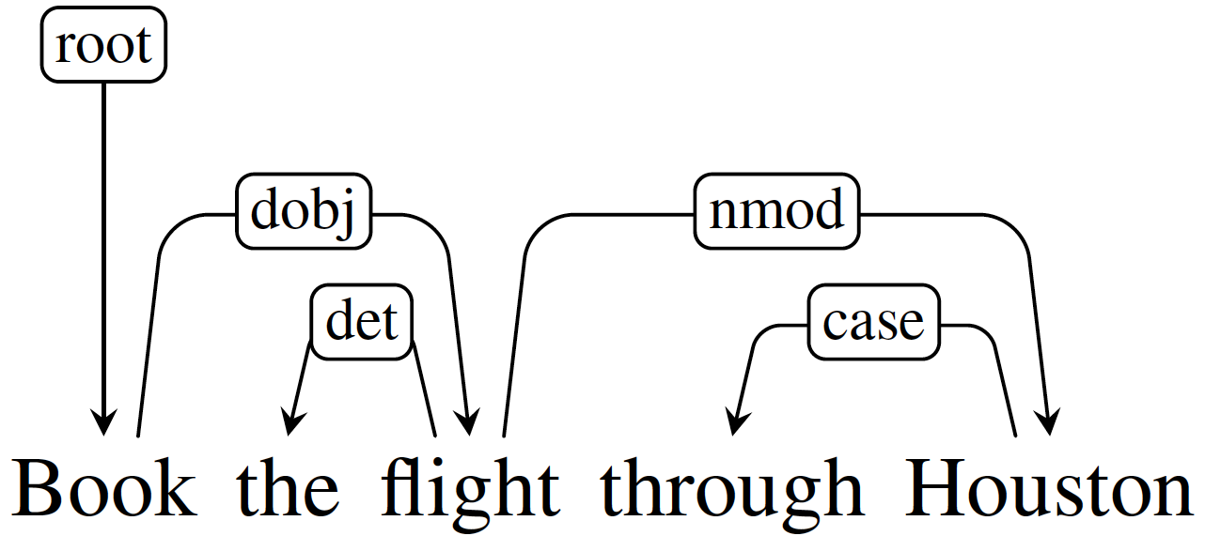
Arc-eager algorithm: motivation
This relation created only at step 8 by arc-standard, even though these words show up early in the input
Too many chances to mess up!

Slide 42
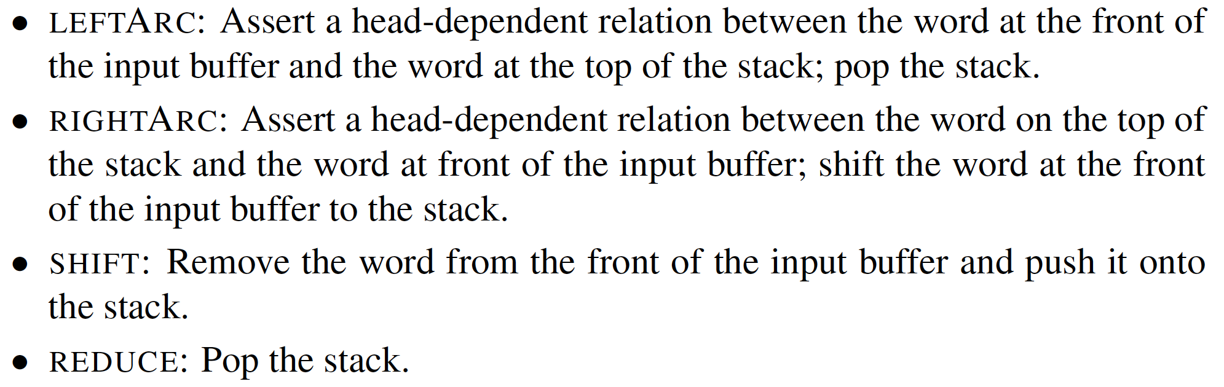
Arc-eager: actions
These changes make arc-eager a top-down algorithm, while arc-standard is bottom-up. Why?

Slide 43
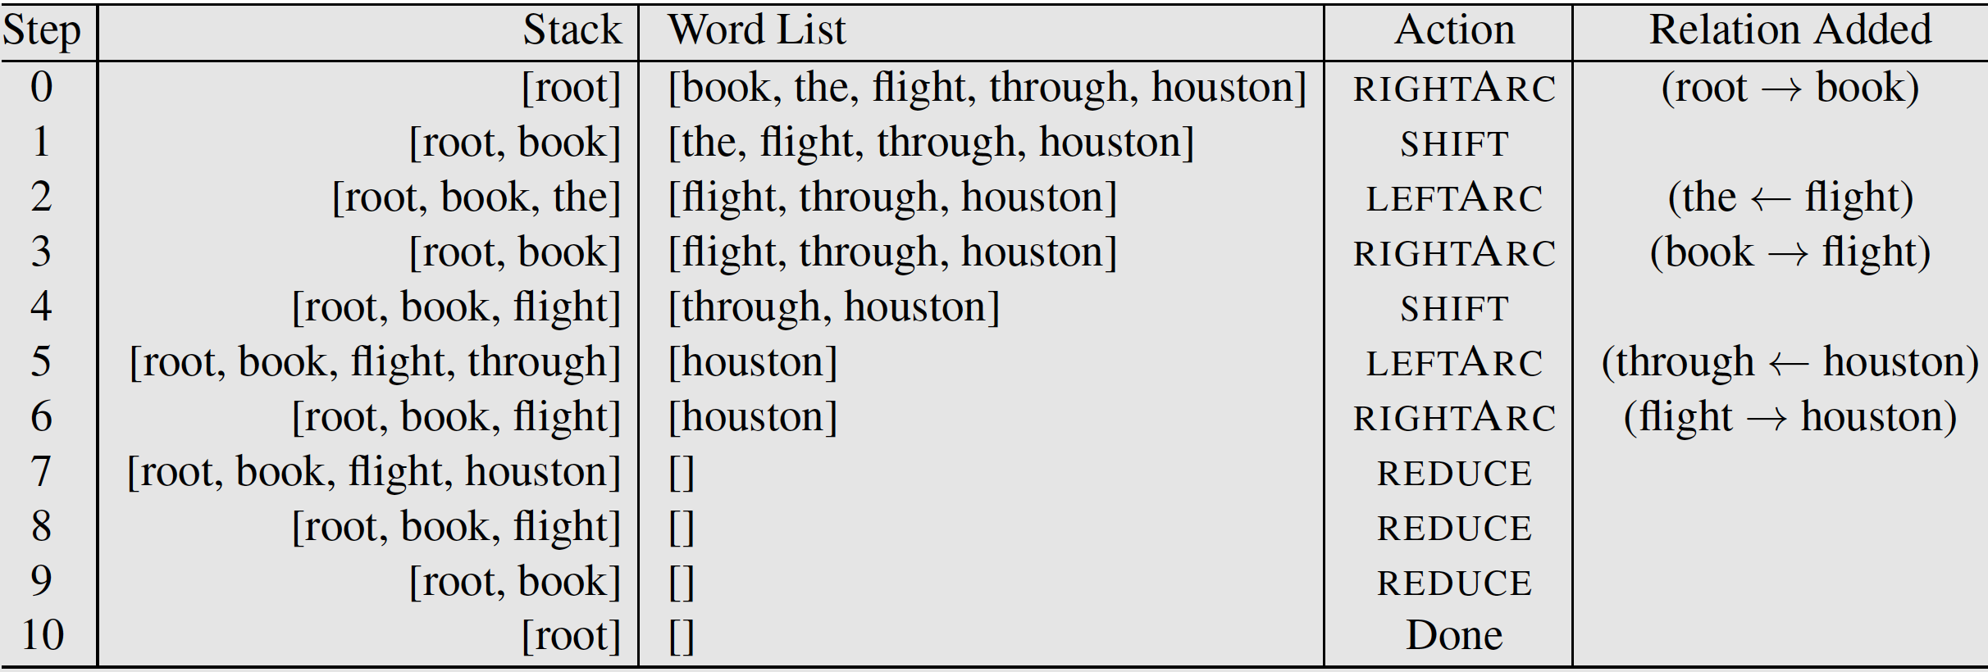
Arc-eager example

Slide 44
Practice Exercise
Generate the program trace for the arc-eager algorithm for the sentences:
John Doe visited China.
I saw a girl with the telescope.
They told him a story.

Slide 45
Handling non-projective trees
Not required
If curious, see:
Joakim Nivre. Non-Projective Dependency Parsing in Expected Linear Time. https://stp.lingfil.uu.se/~nivre/docs/acl09.pdf
Hint: added the SWAP action

Slide 46
Ensemble of shift-reduce parsers
In practice, arc-eager and arc-standard perform relatively similarly
But they are different enough to be useful in an ensemble model
How would you build such an ensemble?

Slide 47
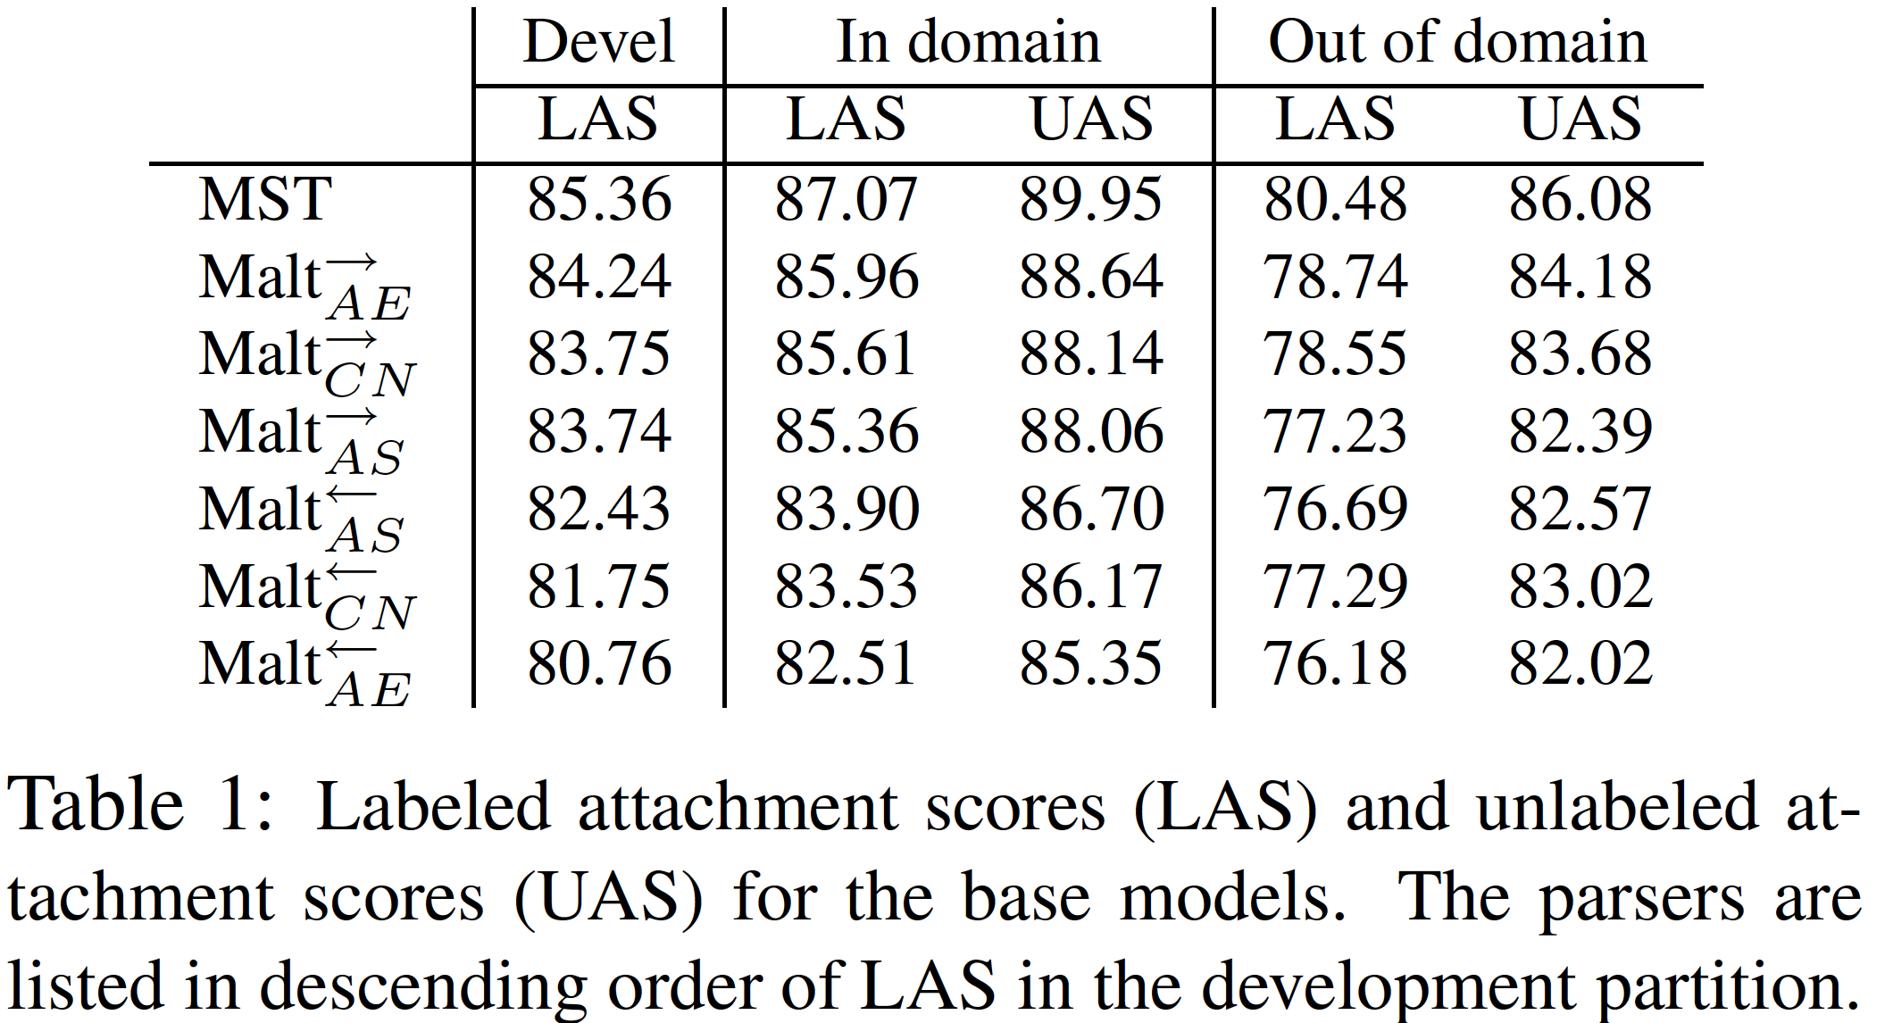
Participants in the ensemble

Slide 48
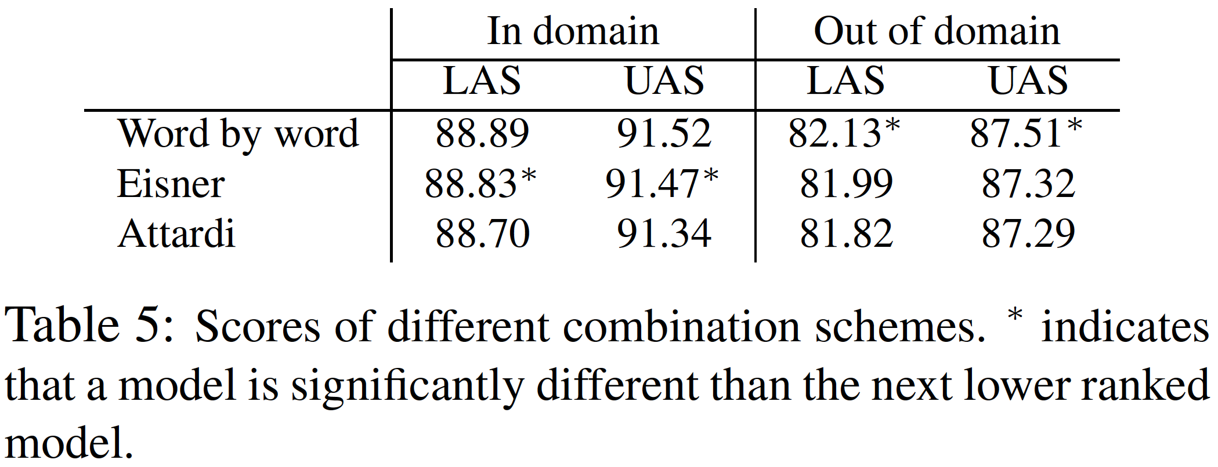
Ensemble results
Trivial to implement; nearly 2 points higher than the best individual model

Slide 49
Take-away
Shift-reduce dependency parsing algorithms for projective trees
Shift-reduce dependency parsing algorithms for directed acyclic graphs
Tree LSTMs

Slide 50
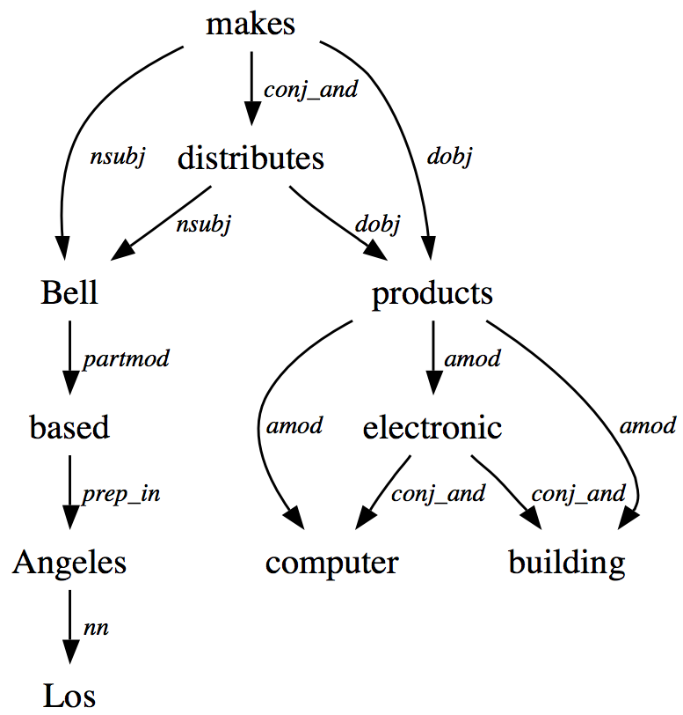
DAG syntax = multiple heads
Collapsed/enhanced syntactic dependencies allow a word to have multiple heads:
Why is this problematic for arc-standard?

Slide 51
Arc-standard revisited
Problem operations

Slide 52
Arc-eager revisited
Problem operation

Slide 53
Main intuition
Don’t pop elements from the stack when an arc is created
This allows them to be attached to multiple heads
This leads to 5 actions
Shift, LeftAttach, RightAttach, LeftReduce, RightReduce

Slide 54
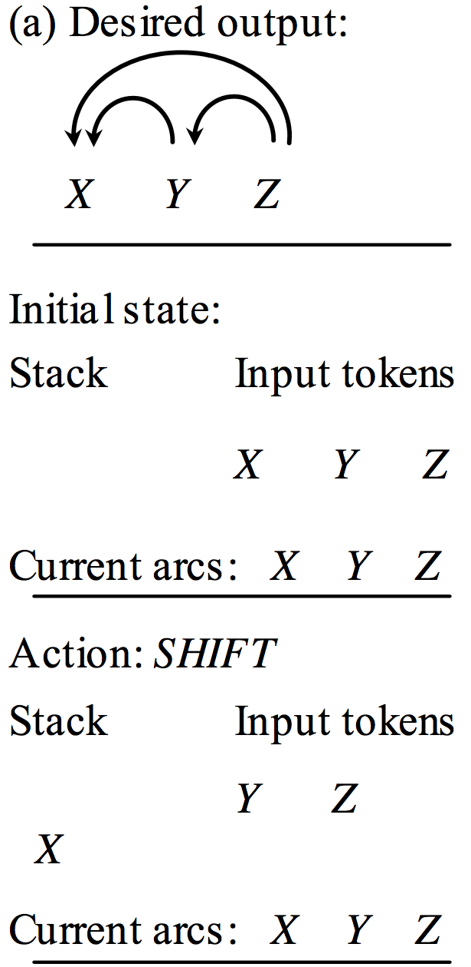
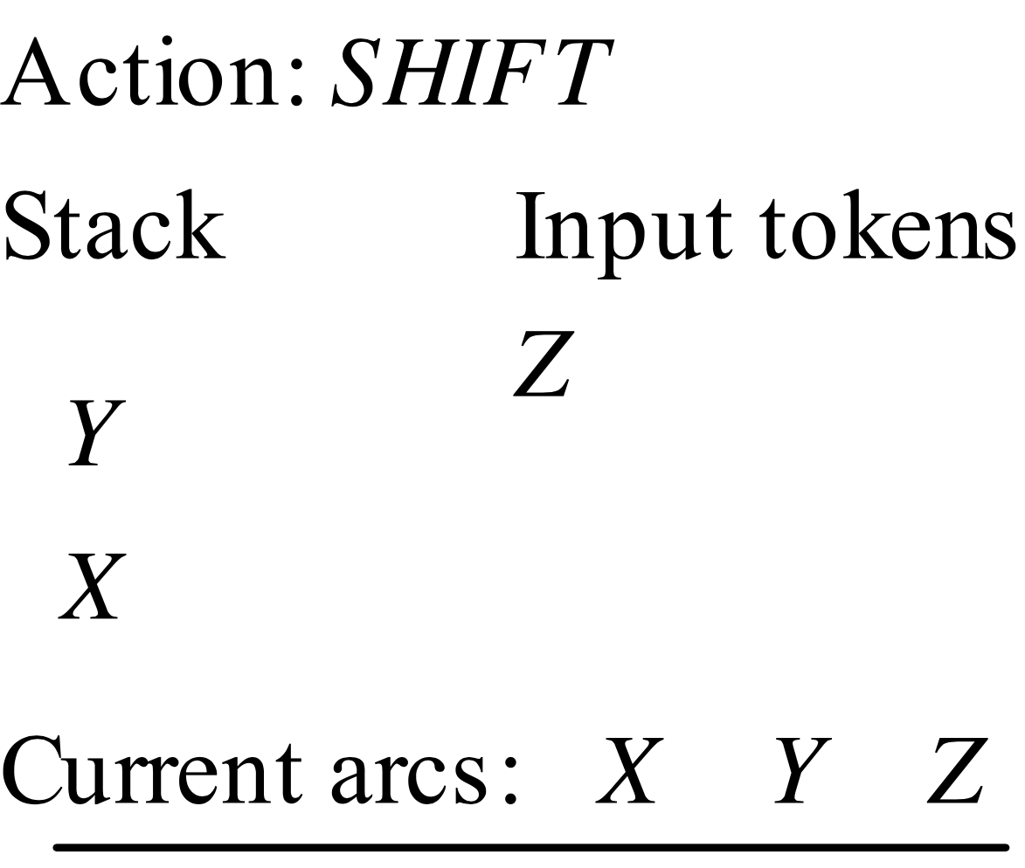
Walkthrough example 1
Shift: same as before

Slide 55
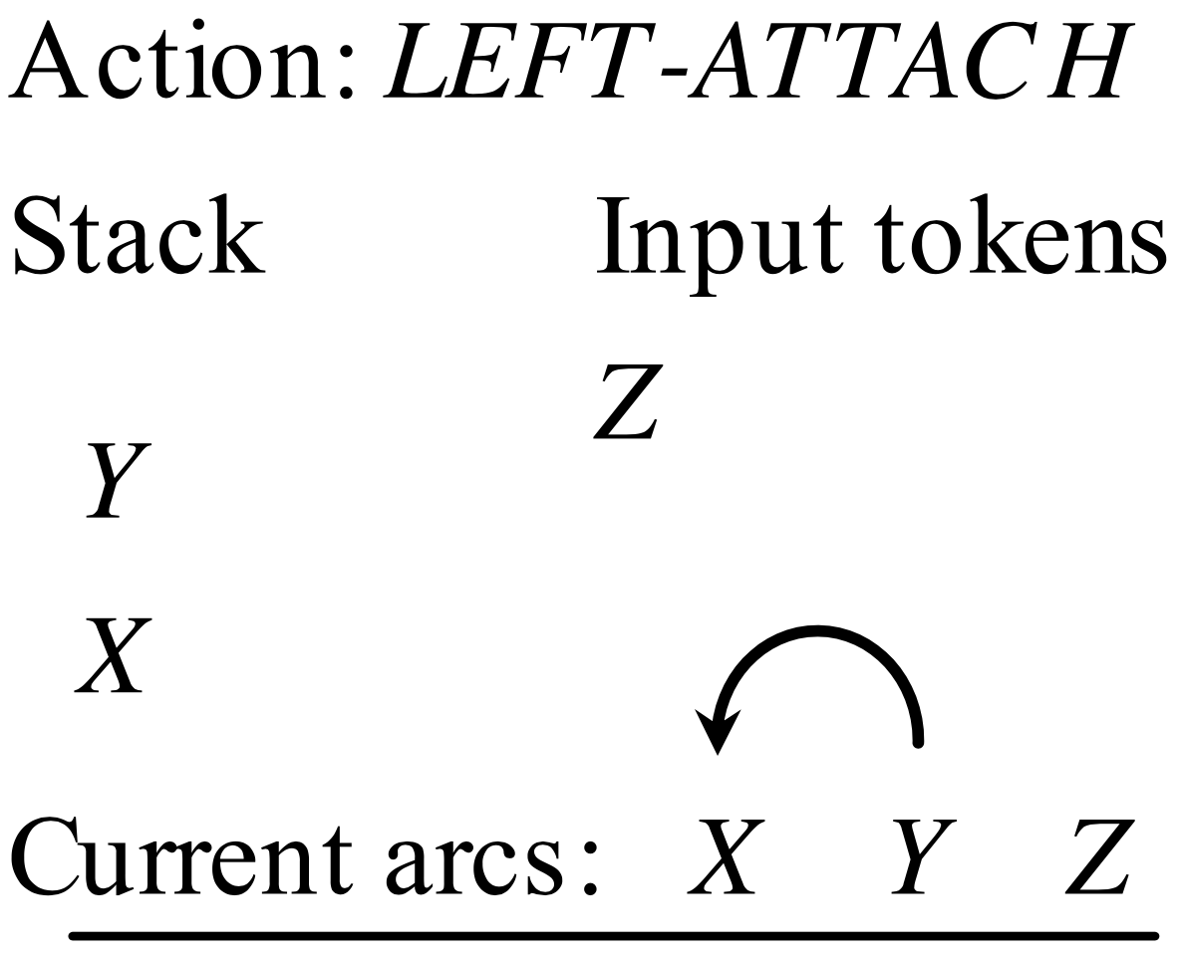
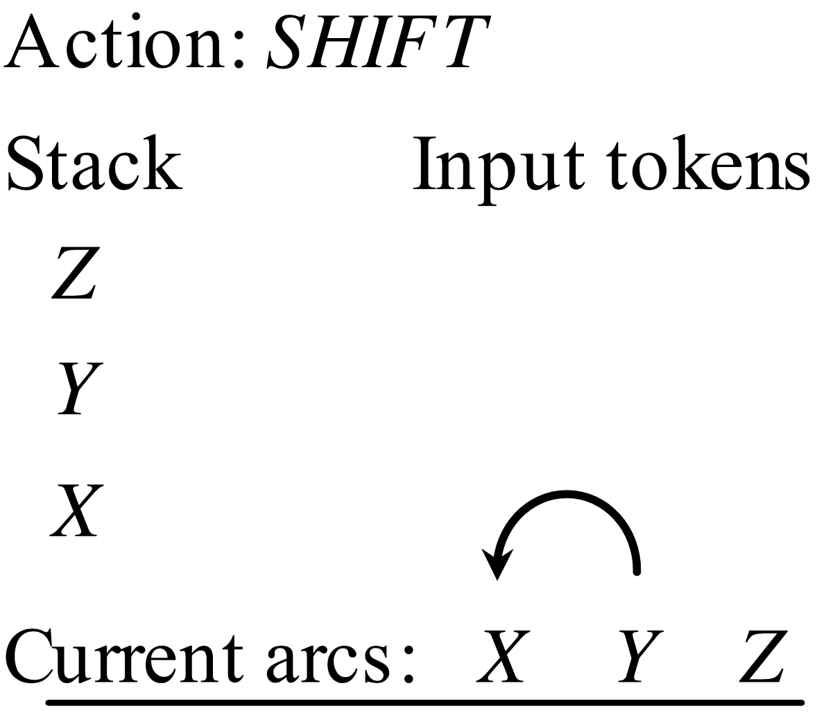
Walkthrough example 1
LeftAttach: creates a left dependency arc between the top two elements on the stack, as long as a right arc does not exist. No element is removed!

Slide 56
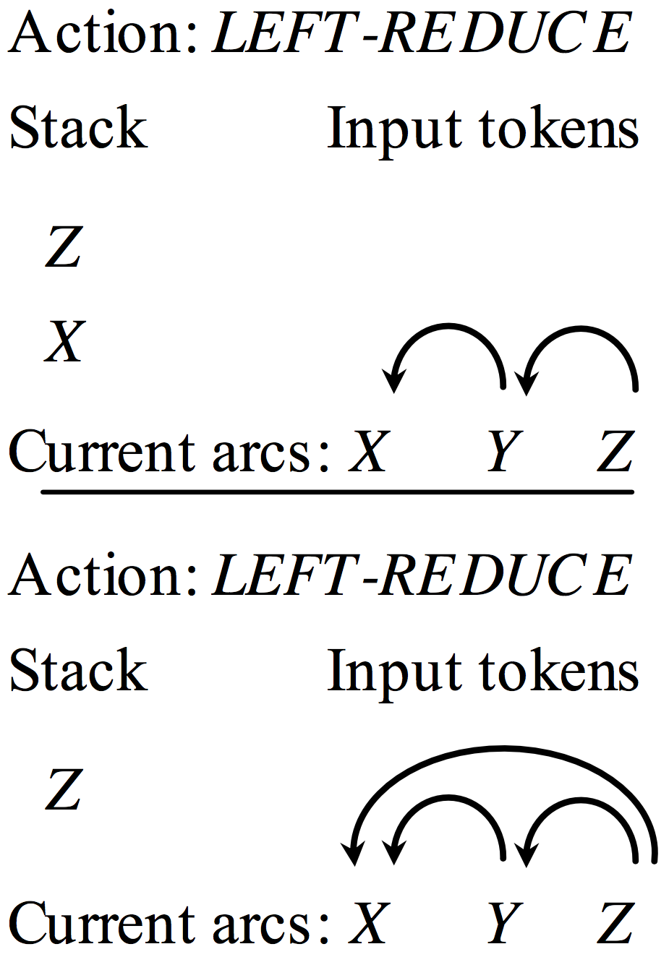
Walkthrough example 1
LeftReduce: similar to LeftAttach but remove the modifier from the stack

Slide 57
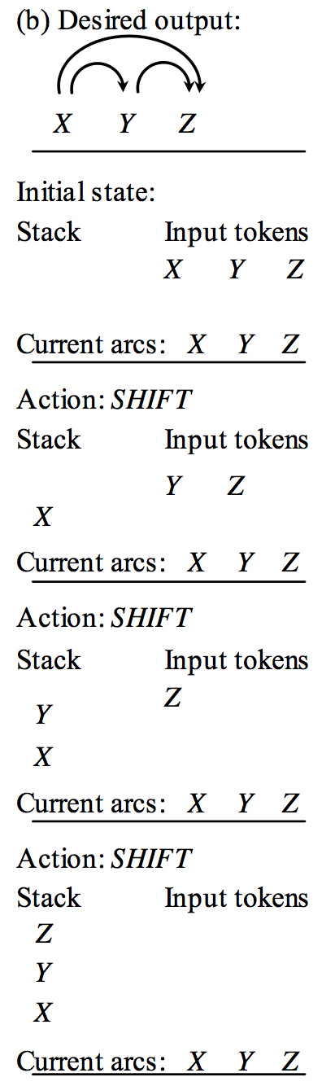
Walkthrough example 2

Slide 58
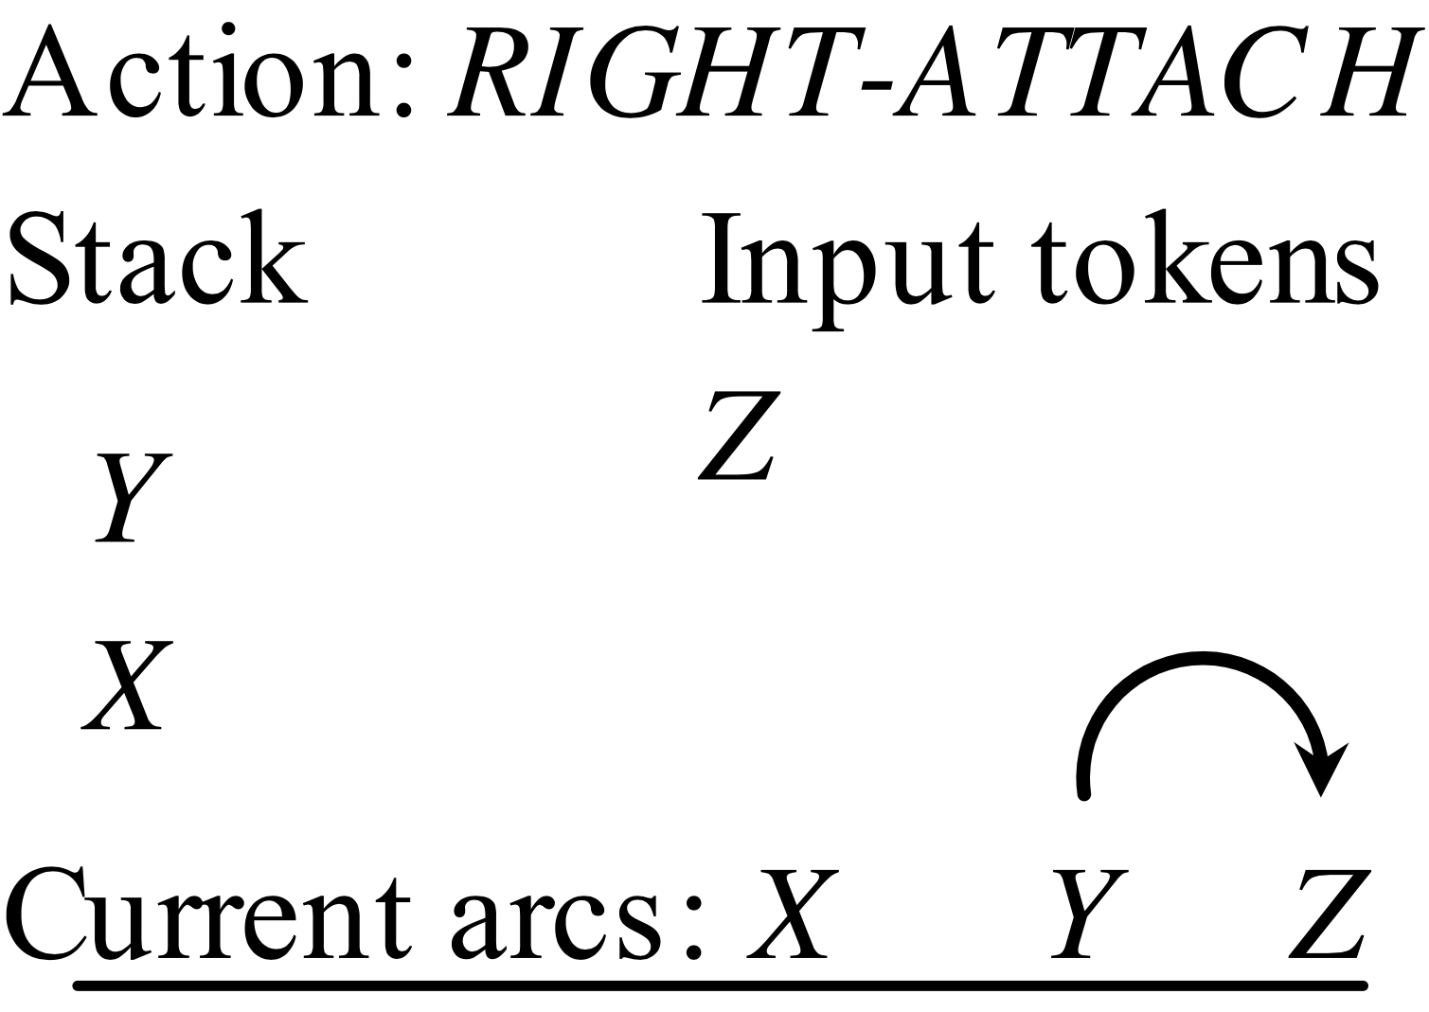
Walkthrough example 2
RightAttach: creates a right dependency between the top 2 elements on the stack, and pushes the top element on the stack back in the input buffer
Notes:
So the dependency between X and Y can be created in the next step

Slide 59
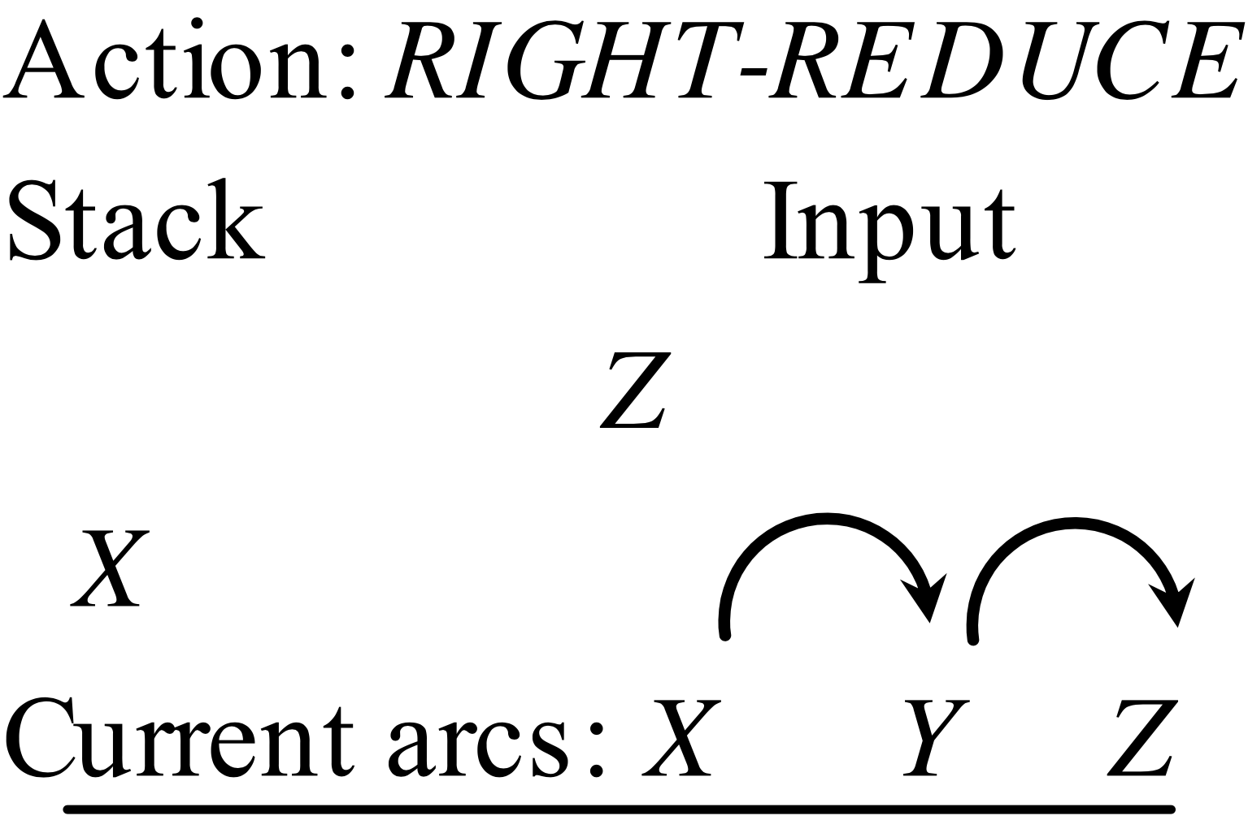
Walkthrough example 2
RightReduce: same as LeftReduce, but creates a right dependency arc
Dependency between X and Y enabled because of the previous push back in the input buffer!
Notes:
So the dependency between X and Y can be created in the next step

Slide 60
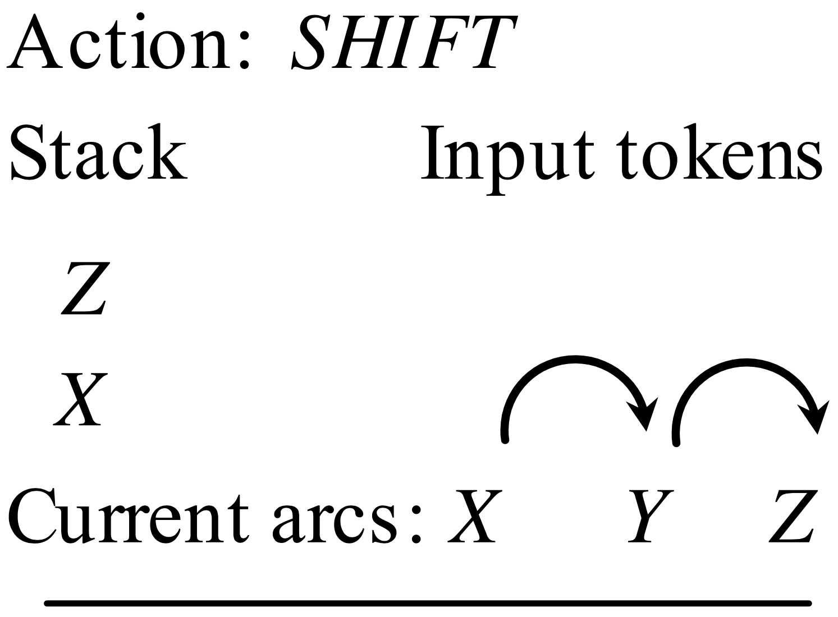
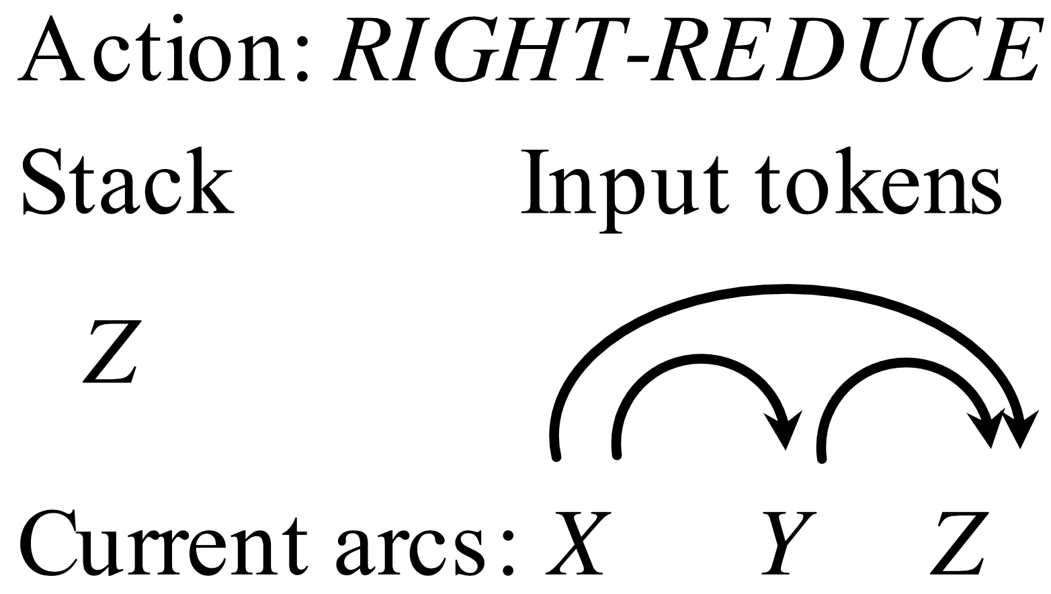
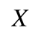
Walkthrough example 2
Notes:
So the dependency between X and Y can be created in the next step

Slide 61
Take-away
Shift-reduce dependency parsing algorithms for projective trees
Shift-reduce dependency parsing algorithms for directed acyclic graphs
Tree LSTMs

Slide 62
Motivation
Ok, so now we can generate a syntactic representation of a sentence.
Can we use this to improve existing semantic tasks such as sentiment analysis?

Slide 63
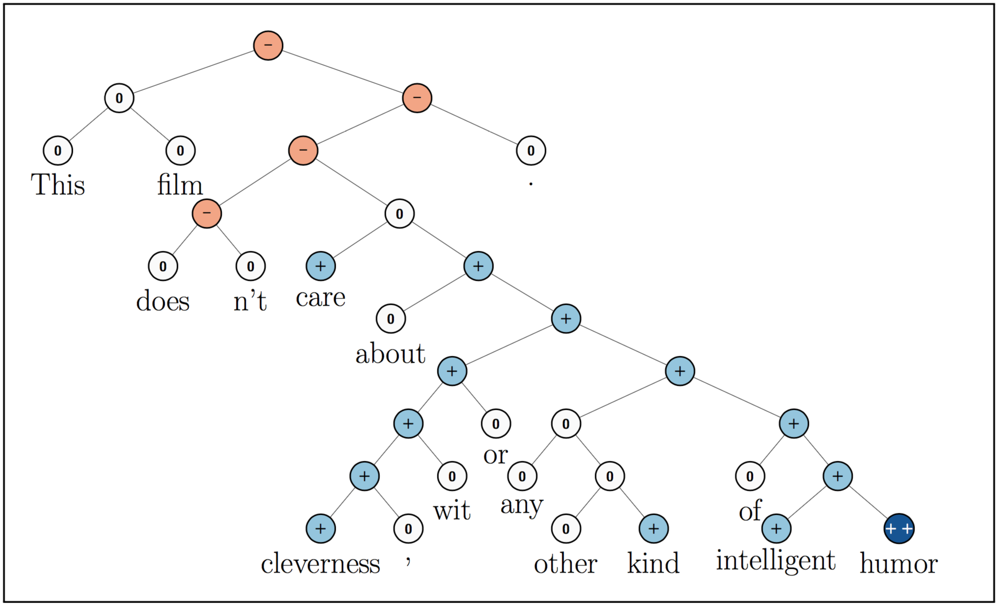
Motivation
Stanford sentiment treebank: https://nlp.stanford.edu/sentiment/

Slide 64
Motivation
We will use LSTMs tailored for trees to capture this information!

Slide 65
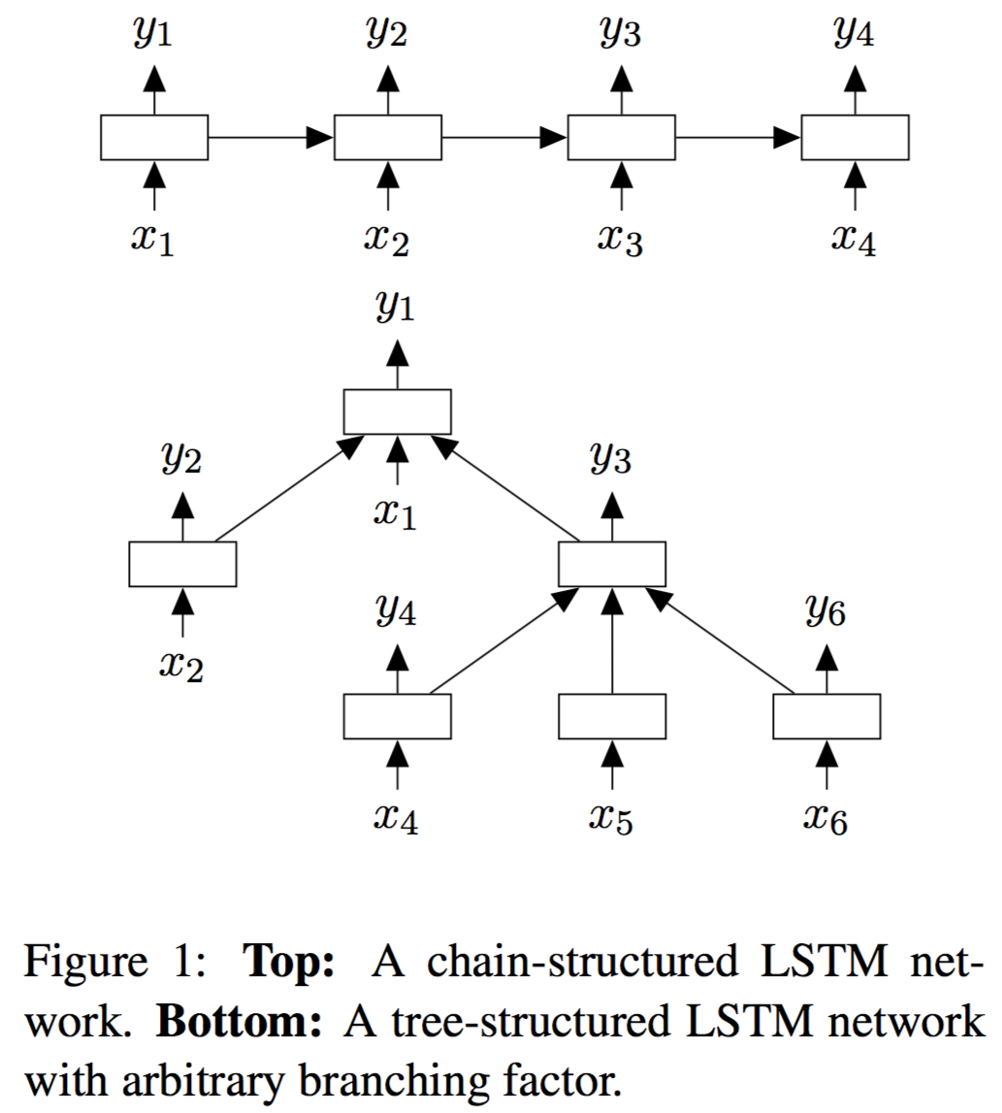
Tree LSTMs vs. chain LSTMs

Slide 66
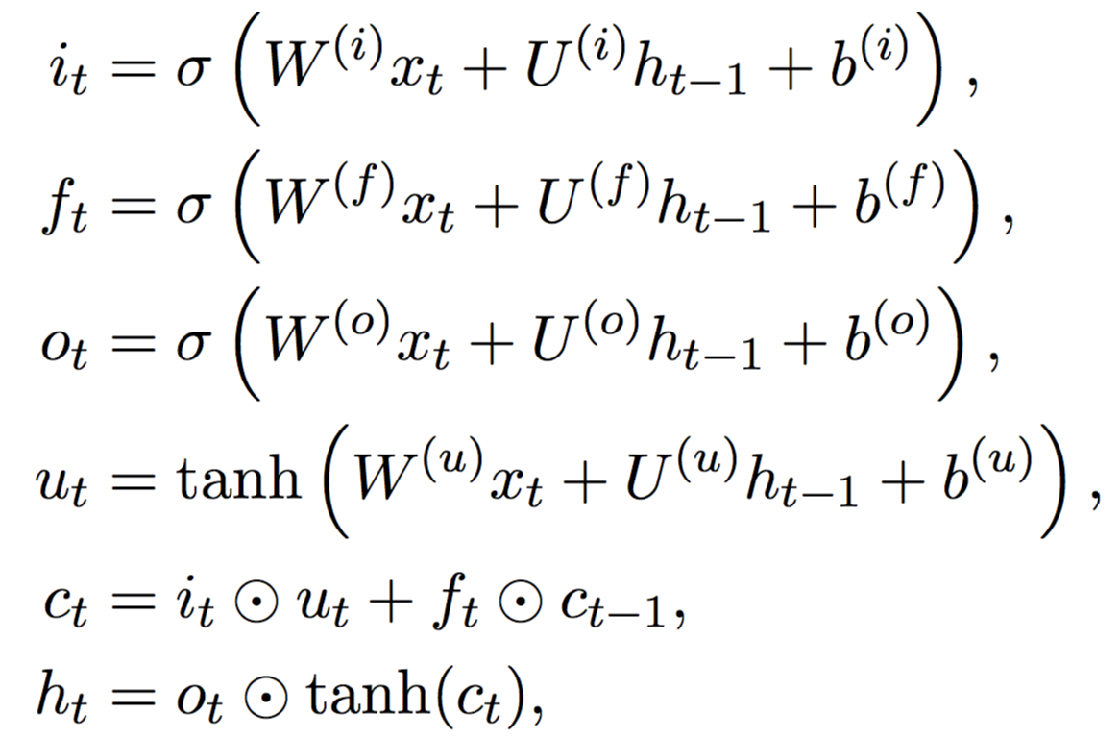
Review of chain LSTMs
Strict left-to-right chaining!

Slide 67
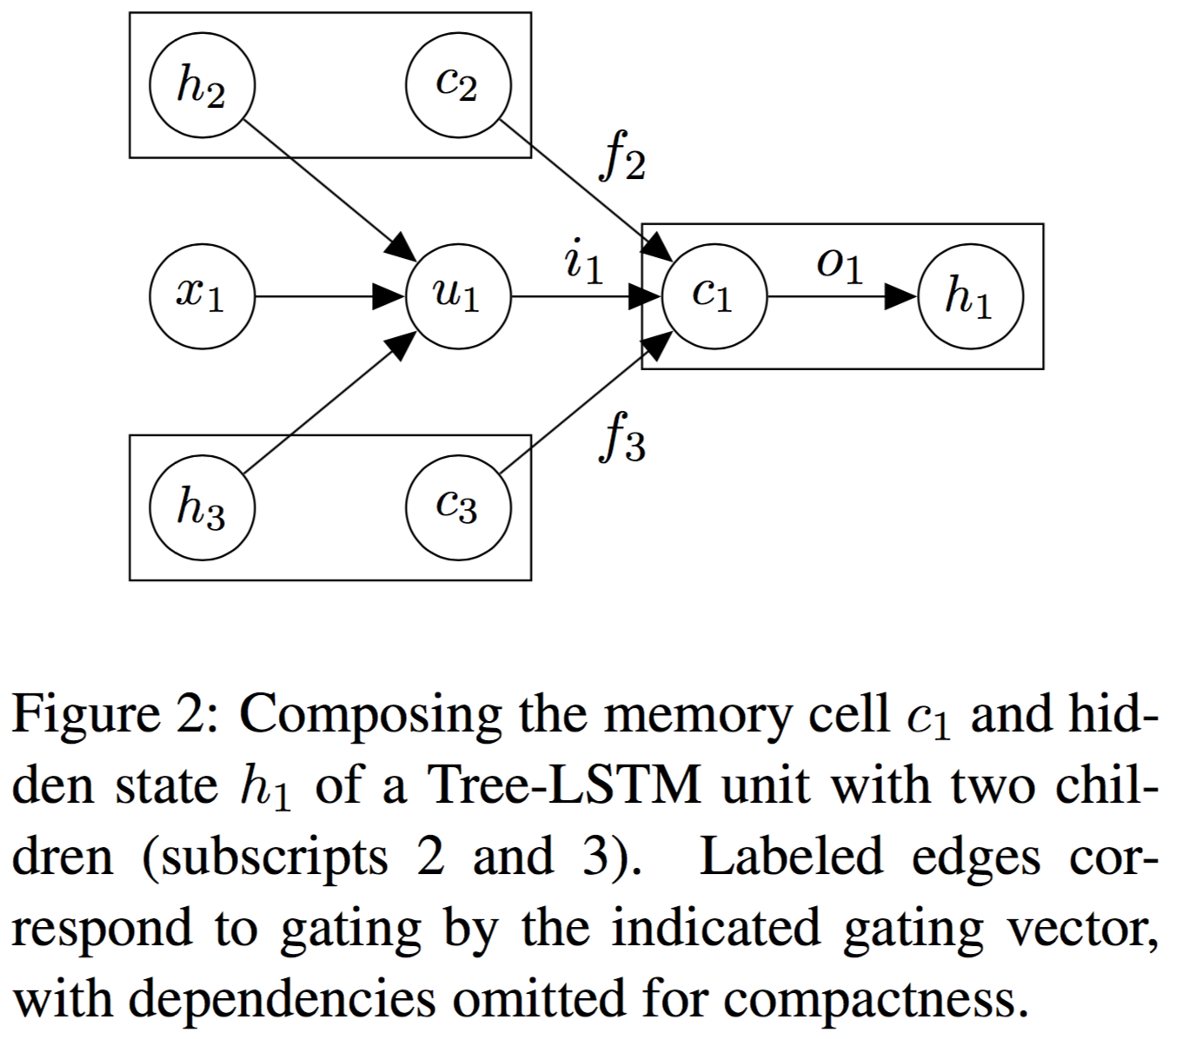
Child-sum Tree-LSTMs

Slide 68
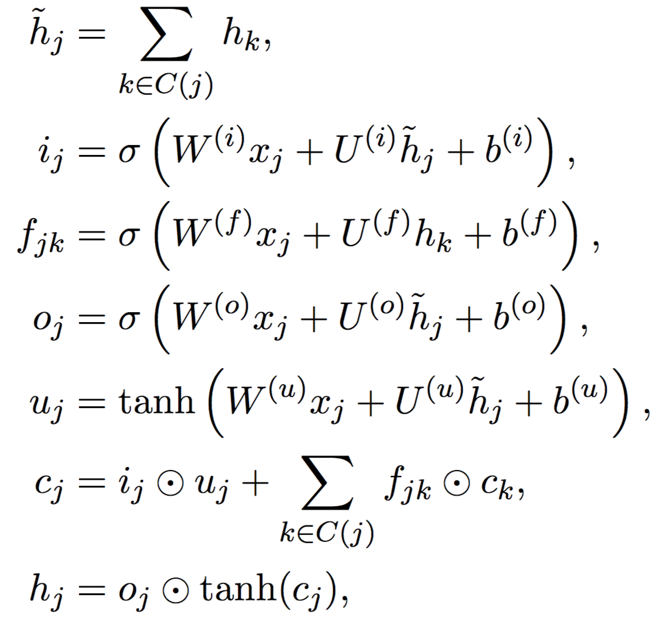
Child-sum Tree-LSTMs
C(j) = all children of node j
How much we are forgetting from child k of node j

Slide 69
N-ary Tree-LSTMs
Applied to tree structures where
The branching factor is at most N
Children are ordered from 1 to N
Unlike the previous model, this one has separate parameter matrices per child (rather than one per sum of children)

Slide 70
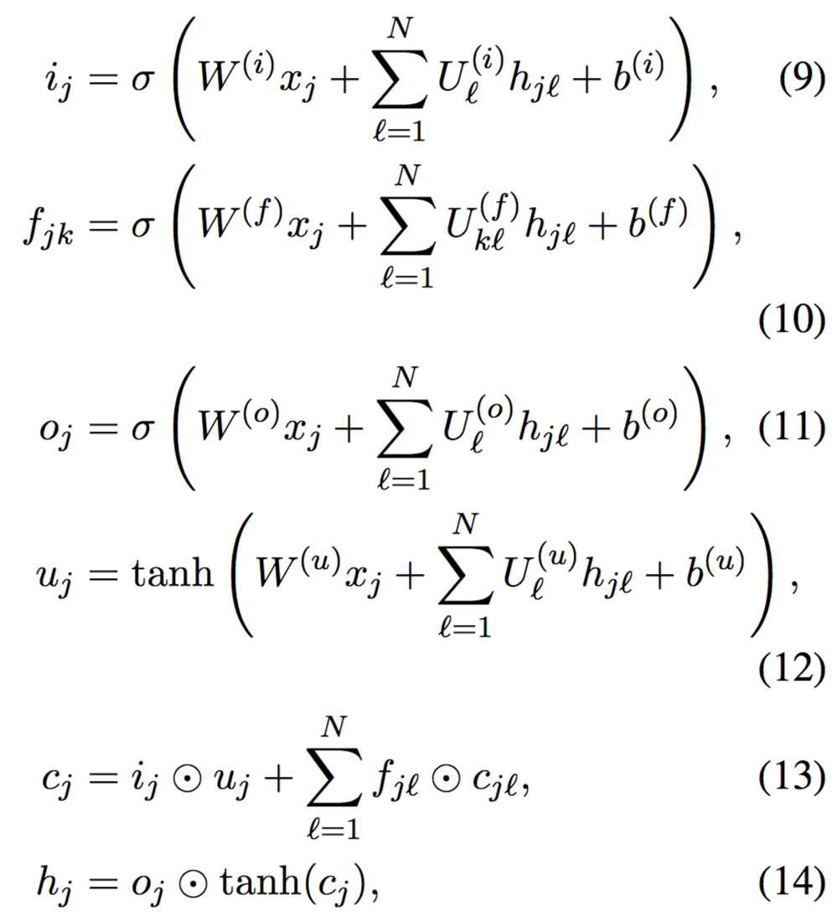
N-ary Tree-LSTMs
I think this is a bug in the paper. Why?

Slide 71
Encoder for sentiment analysis
The authors trained an encoder on the final output of these LSTMs (h_{N}), where the output is fed into a softmax layer to predict the sentiment label for the whole sentence
Trained using the usual negative log likelihood cost function, and L2 regularization

Slide 72
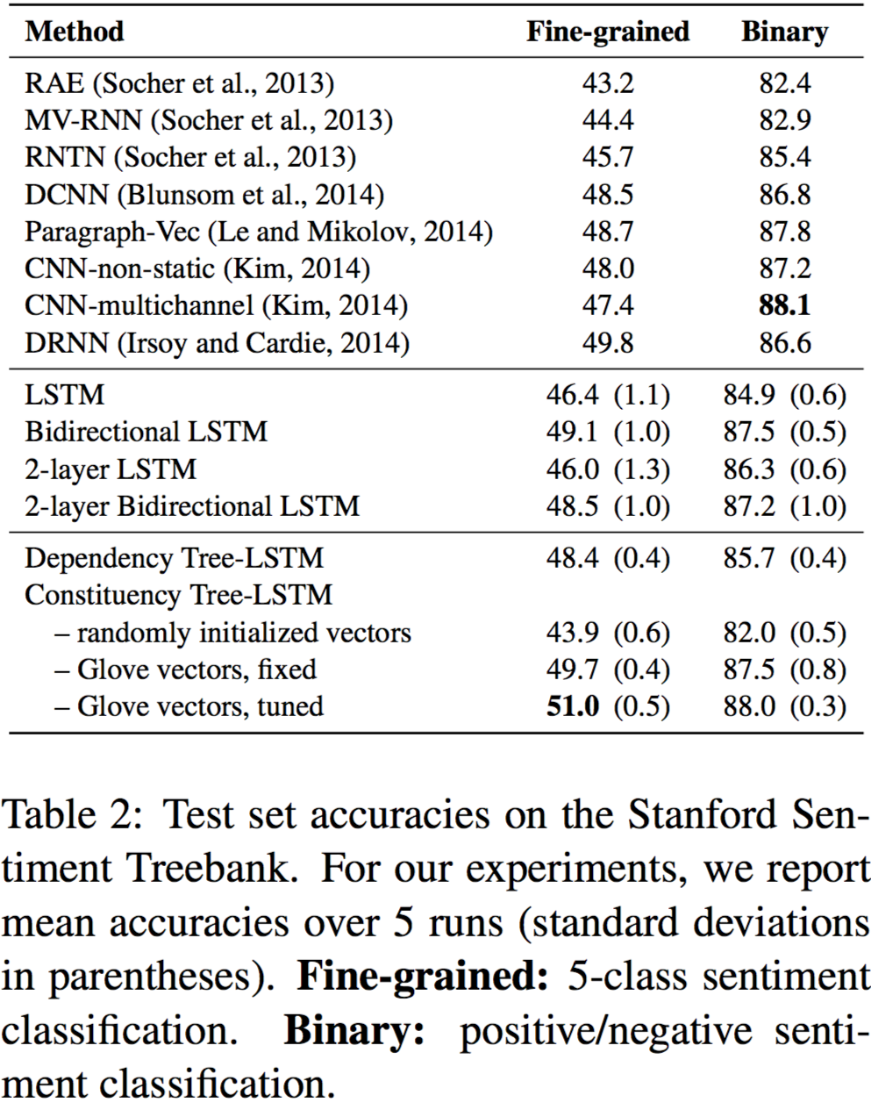
Results on the Stanford sentiment treebank

Slide 73
Take-away
Shift-reduce dependency parsing algorithms for projective trees
Shift-reduce dependency parsing algorithms for directed acyclic graphs
Tree LSTMs

